Slide 1
MEC 135-BASICS OF MECHANICAL engineering L : 2, T: 1, P: 0 Credit: 3
Dr. Ravinder Pal Singh,
Professor,
Lovely Professional University, Punjab.

Slide 2
Course ATTAINMENT
CO1: understand the fundamentals of engineering drawing including usages of drawing tools, line-types, dimensioning, letter-writing, and other conventions.
CO2: recognize and apply the conceptual framework of orthographic projections and acquire visualization and drawing skills on both grid-sheets and software.
CO3: learn the procedures to draw the isometric views of few commonly used objects on both grid sheets and software.
CO4: understand the usages of sectioning and to draw sectioned views on both grid-sheets and software.
CO5: impart the conceptual knowledge of digital fabrication using RPT and its fundamentals.

Slide 3
COURSE CONTENT
Unit- I | Introduction to Engineering Drawing: Principles of engineering drawing and its significance, drawing instruments, line-types, dimensioning, single stroke vertical Gothic letter writing, BIS norms
Unit- II | Orthographic Projections: Introduction, principle, orthographic projections in both first and third angle projections systems, practice, introduction to AutoCAD environment
Unit- III | Sectional Views: Introduction, principle, importance, types- full section, offset section, half section, practice, 2D drawings on AutoCAD
Unit- IV | Isometric Projections: Introduction, principle, terminology, isometric scale, isometric views of step, inclined, oblique, and cylindrical blocks, isometric dimensioning, practice, 3D modeling on AutoCAD
Unit- V | Introduction to Digital Fabrication: Need of digital manufacturing, prototype, types and roles of prototypes, rapid prototyping (RPT), phases of RPT, fundamentals of RPT, advantages, practice of 2D and 3D modelling on AutoCAD
Unit- VI | Rapid Prototyping: Classification of RPT systems, process chain, 3D modelling, data conversion, checking-building-postprocessing, Stereolithography (STL)- process, principle, CAD for RPT, conversion of STL file from 3D solid models

Slide 4
TEXT BOOKS AND REFERENCES
Text Books:
Engineering Drawing with an Introduction to AutoCAD, Dhananjay A. Jolhe, McGraw Hill Education.
Rapid Prototyping- Principles and Applications (2nd edition), Chua, C.K., Leong, K.F., Lim, C.K., World Scientific Publications, London
References:
Engineering Graphics, K C John, Prentice Hall
Engineering Drawing, N.D. Bhat & M. Panchal, Charotar Publishing House Pvt. Ltd.
Manufacturing Engineering and Technology (3rd edition), Serope Kalpakjian, Addison-Wesley Publications, Boston

Slide 5
Course evaluation
CONTINUOUS ASSESSMENT : 3 (C010102) 30
MID TERM: 1 25
END TERM: 1 40
ATTENDANCE 5

Slide 6
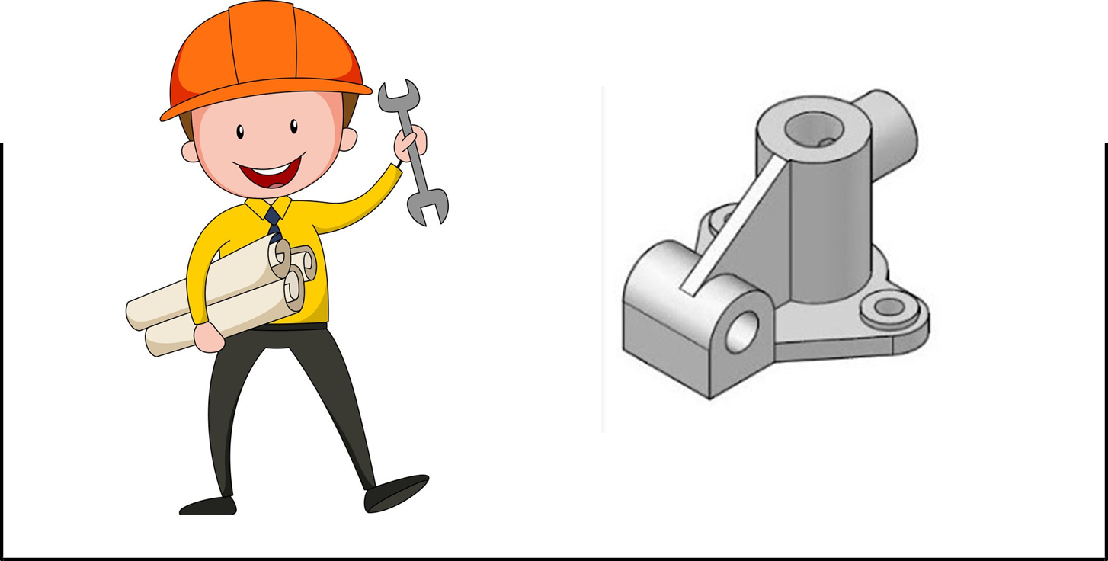
Introduction to Engineering Drawing

Slide 7
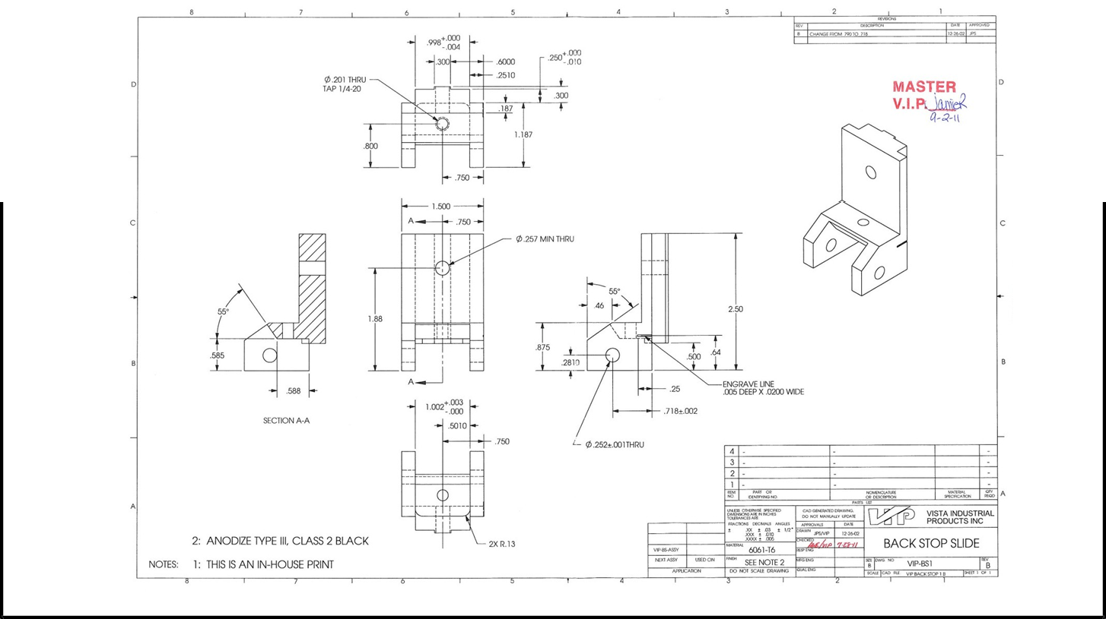
Introduction to Engineering Drawing

Slide 8
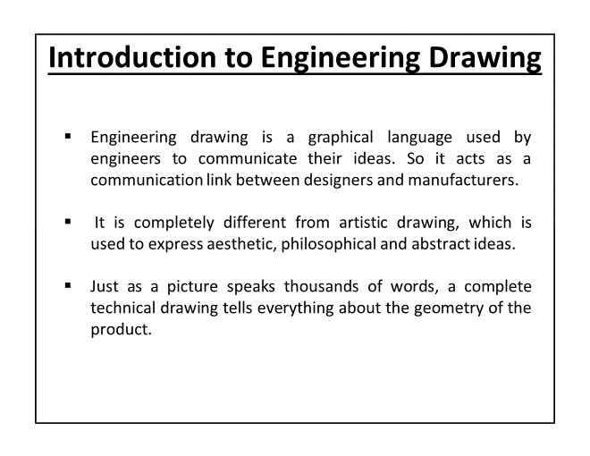

Slide 9
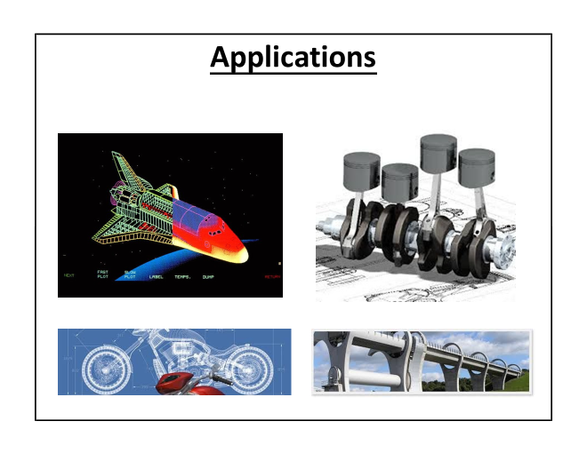

Slide 10
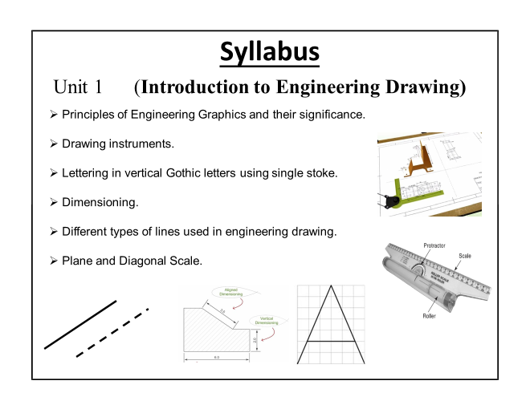
BIS Norms

Slide 11
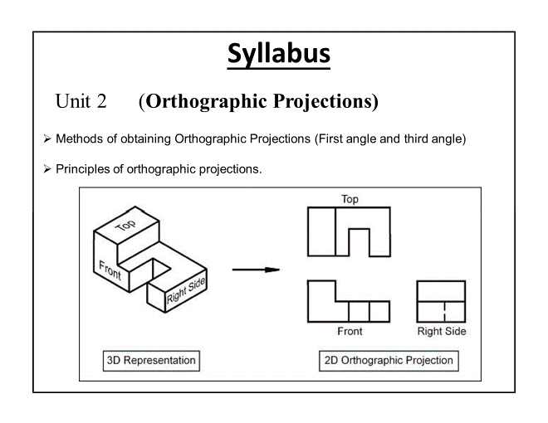
Syllabus
Unit 2- Orthographic Projections
Principles,
Methods of obtaining orthographic projection (First angle and third angle),
Introduction to Auto CAD environment

Slide 12
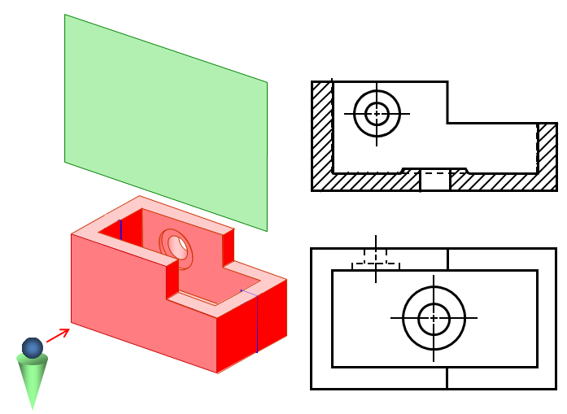
Syllabus
Unit 3- Sectional Views
Introduction, Principle, Importance,
Types- Full Section, Offset Section, Half Section, Practice,
2D Drawings On Auto CAD

Slide 13
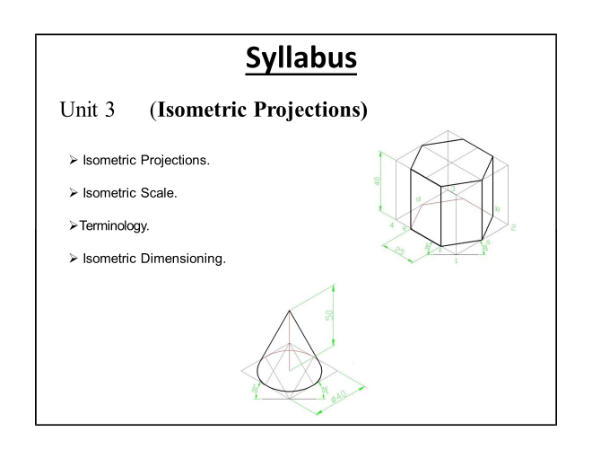
4
3D modelling on AutoCAD

Slide 14
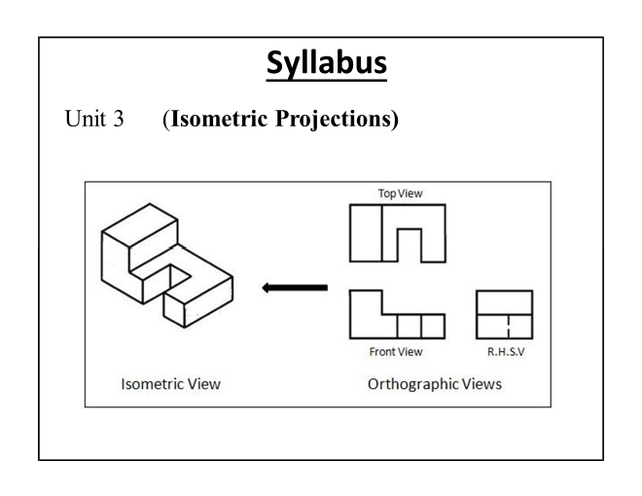
4

Slide 15
Syllabus
Unit 5- Introduction to Digital Fabrication
Need of Digital Manufacturing,
Prototype, types and roles of prototypes,
Rapid Prototyping (RPT), phases of RPT, fundamentals, advantages,
Practice of 2D and 3D modeling on Auto CAD

Slide 16
Syllabus
Unit 6- Rapid Prototyping
Classification of RPT systems,
Process chain, 3D modeling, data conversion,
Checking-building-post-processing,
Stereolithography (STL)- process, principle,
CAD for RPT,
conversion of STL file from 3D solid models

Slide 17
Benefits of Engineering Drawing in CSE
Every engineer should have the ability to express own ideas in the form of drawings to convey to the manufacturer,
Technical drawing allows efficient communication among engineers and can be kept as a record of the planning process,
Designing of computer gadgets/hardware can be accomplished knowing the basics of engineering drawing,
Drawing and converting 2D sketches in 3D models are also the critical criterion in game design.

Slide 18
Benefits of Digital Manufacturing in CSE
Rapid Prototyping helps designers to present new concepts to board members/clients/investors for facile understanding and approval of novel product,
It assists to test different components and refine your ideas, providing a clear pathway from concept to reality,
Reducing product development costs,
Allowing functionality testing

Slide 19
Benefits of Digital Manufacturing in CSE
Eliminating the risk of product failure,
Improving user (and stakeholder) involvement,
Increased efficiency through automated exchange of data,
Avoidance of costly errors due to missed or misinterpreted data,
Digital tools allow manufacturers to centralize and manage the entire manufacturing process in one software platform,

Slide 20
https://www.youtube.com/watch?v=Ah_gbB5gflI
THANKS

